Slide 1

Sample # 01
Select Element
Select Attribute
Select Operation
Application Component
None
Criticality
Operation Applied on
Element
Attribute
Select Chart Type
Column
Generate Chart

Slide 2
Sample # 01
Element / Application Component | Attribute / Criticality (Very High, High, Medium, Low, Very Low)
Application Component 0001 | Very High
Application Component 0002 | High
Application Component 0003 | Medium
Application Component 0004 | Very High
Application Component 0005 | Very Low
Application Component 0006 | Low
Application Component 0007 | Medium
Application Component 0008 | Low

Slide 3
Sample # 01
Application Criticality
Criticality
Very High
High
Medium
Low
Very Low
Application Component 0003
Application Component 0006
Application Component 0008
Application Component 0002
Application Component 0005
Application Component 0007
Application Component 0001
Application Component 0004
Application Component

Slide 4

Sample # 02
Select Element
Select Attribute
Select Operation
Application Component
Count
Criticality
Operation Applied on
Element
Attribute
Select Chart Type
Column
Generate Chart

Slide 5
Sample # 02
Element / Application Component | Attribute / Criticality (Very High, High, Medium, Low, Very Low)
Application Component 0001 | Very High
Application Component 0002 | High
Application Component 0003 | Medium
Application Component 0004 | Very High
Application Component 0005 | Very Low
Application Component 0006 | Low
Application Component 0007 | Medium
Application Component 0008 | Low
Application Component 0009 | Medium
Application Component 0010 | Very High
Application Component 0011 | Low
Application Component 0012 | Low

Slide 6
Sample # 02
Application Criticality
Number of Applications
10
8
6
4
2
Very High
High
Medium
Low
Very Low
Criticality

Slide 7
Sample # 03
Select Element
Select Attribute
Select Operation
Application Component
Count
Scalability
Availability
Usability
Modularity
Continuity
Composability
Operation Applied on
Element
Attribute
Select Chart Type
Clustered Column
Generate Chart

Slide 8
Sample # 03
Element / Application Component | Attribute / Scalability | Attribute / Availability | Attribute / Usability | Attribute / Modularity | Attribute / Continuity | Attribute / Composability
Application Component 0001 | Very High | High | Very High | High | Very Low | Medium
Application Component 0002 | Low | High | Very Low | High | Low | Low
Application Component 0003 | High | Very High | Medium | High | Medium | Very High
Application Component 0004 | Medium | High | Very High | Very High | Very Low | Very Low
Application Component 0005 | Low | Very Low | High | Very Low | Very Low | Medium
Application Component 0006 | Medium | Medium | Very High | High | Very Low | Very Low
Application Component 0007 | Very Low | Medium | Very High | Very Low | Very Low | Low
Application Component 0008 | Very High | Medium | Low | Medium | Medium | High
Application Component 0009 | Medium | Very Low | High | High | Very Low | Medium
Application Component 0010 | Very High | Medium | High | Very Low | Low | Very High
Application Component 0011 | Very Low | Very High | Medium | High | High | Medium
Application Component 0012 | Low | Very Low | Very High | Very High | Medium | Very Low

Slide 9
Sample # 03
Application Maturity
Number of Applications
10
8
6
4
2
Scalability
Availability
Usability
Modularity
Continuity
Composability
Application Characteristics
Very High
High
Medium
Low
Very Low

Slide 10
Sample # 04
Select Element
Select Attribute
Select Operation
Application Component
Average
Scalability
Availability
Usability
Modularity
Continuity
Composability
Operation Applied on
Element
Attribute
Select Chart Type
Column
Note: We will discuss later how to color bars in this case.
Generate Chart

Slide 11
Sample # 04
Element / Application Component | Attribute / Scalability | Attribute / Availability | Attribute / Usability | Attribute / Modularity | Attribute / Continuity | Attribute / Composability | Chart Value/ Maturity Score
Application Component 0001 | 5 | 4 | 5 | 4 | 1 | 3 | 3.67
Application Component 0002 | 1 | 4 | 1 | 4 | 1 | 1 | 2.00
Application Component 0003 | 4 | 5 | 3 | 4 | 3 | 5 | 4.00
Application Component 0004 | 3 | 4 | 5 | 5 | 1 | 1 | 3.17
Application Component 0005 | 5 | 5 | 5 | 5 | 5 | 5 | 5.00
Application Component 0006 | 3 | 3 | 5 | 4 | 1 | 1 | 2.83
Application Component 0007 | 1 | 3 | 5 | 1 | 1 | 1 | 2.00
Application Component 0008 | 5 | 3 | 1 | 3 | 3 | 4 | 3.17
Application Component 0009 | 3 | 1 | 4 | 4 | 1 | 3 | 2.67
Application Component 0010 | 5 | 3 | 4 | 1 | 1 | 5 | 3.17
Application Component 0011 | 0 | 0 | 0 | 0 | 0 | 0 | 0
Application Component 0012 | 1 | 1 | 5 | 5 | 3 | 1 | 2.67

Slide 12
Sample # 04
Application Criticality
Maturity Score
5
4
3
2
1
Application Component 0003
Application Component 0006
Application Component 0008
Application Component 0002
Application Component 0005
Application Component 0007
Application Component 0009
Application Component 0001
Application Component 0004
Application Component 0010
Application Component 0011
Application Component 0012
Application Component
Optimized
Managed
Functional
Challenged
Initial
None

Slide 13
Sample # 05
Select Element
Select Attribute
Select Operation
Application Component
Distribution
Utilized Budget
Operation Applied on
Element
Attribute
Select Chart Type
Pie
Generate Chart

Slide 14
Sample # 05
Element / Application Component | Attribute / Utilized Budget
Application Component 0001 | 500000
Application Component 0002 | 254762
Application Component 0003 | 1609235
Application Component 0004 | 34562
Application Component 0005 | 981727
Application Component 0006 | 135467

Slide 15
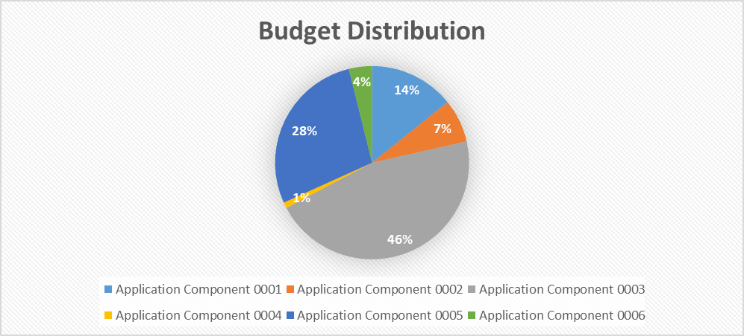
Sample # 05

Slide 16
Sample # 06
Select Element
Select Attribute
Select Operation
Application Component
None
Utilized Budget
Allocated Budget
Operation Applied on
Element
Attribute
Select Chart Type
Clustered Column
Generate Chart

Slide 17
Sample # 06
Element / Application Component | Attribute / Utilized Budget | Attribute / Allocated Budget
Application Component 0001 | 500000 | 500000
Application Component 0002 | 254762 | 300000
Application Component 0003 | 1609235 | 1700000
Application Component 0004 | 34562 | 35000
Application Component 0005 | 981727 | 1000000
Application Component 0006 | 135467 | 200000

Slide 18
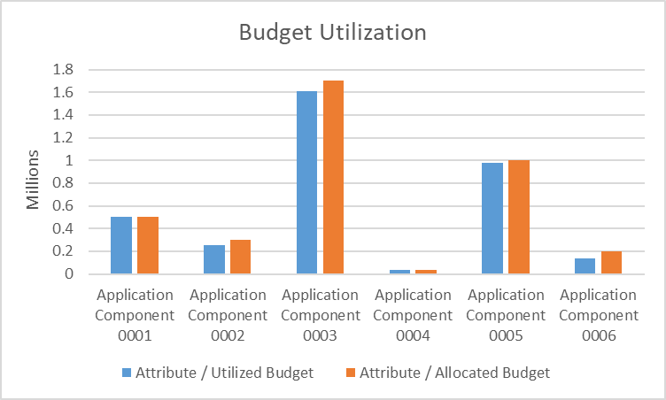
Sample # 06

